Slide 1
Cystic Fibrosis - What You Don't See
Notes:
You'll need to select the option 'enable content' at the start of the slide show presentation, in order to be able to view the videos.

Slide 2
In this lesson, we'll...
Learn about the condition cystic fibrosis (CF).or wear glasses.
Consider how CF affects people's physical and mental health and wellbeing.
Think about the role that positive, supportive relationships play in the lives of those living with CF.

Slide 3
What is cystic fibrosis (CF)?
Cystic fibrosis is an inherited genetic lifelong condition. You are born with CF and cannot catch it later in life, but one in 25 of us carries the faulty gene that causes it, usually without knowing.
People with CF experience a build-up of thick, sticky mucus in the lungs, digestive system and other organs, causing a wide range of challenging symptoms affecting the entire body.

Slide 4
An invisible condition?
Over 10,800 people in the UK are living with cystic fibrosis (CF), but the condition is still widely misunderstood.
It’s often described as an invisible condition because you can't see it or what it does to the body.

Slide 5
Living with CF
Let's meet Kieron, who has CF...

Slide 6
Invisible challenges
In life, we all face challenges. These challenges will be different for different people.
We can't control the challenges that life will present us with, but we can choose how to take on those challenges.
What challenges does Kieron face?

Slide 7
Physical health and wellbeing
Like many medical conditions, CF affects people's bodies. For people with CF, the way their lungs and stomachs work is often affected.
Let's find out about staying physically well with CF.

Slide 8
Physically well
Staying active is really important for everyone, but it's particularly crucial for people with CF.
What forms of exercise were seen or mentioned in the video?
Exercise helps people with CF maintain better lung function.

Slide 9
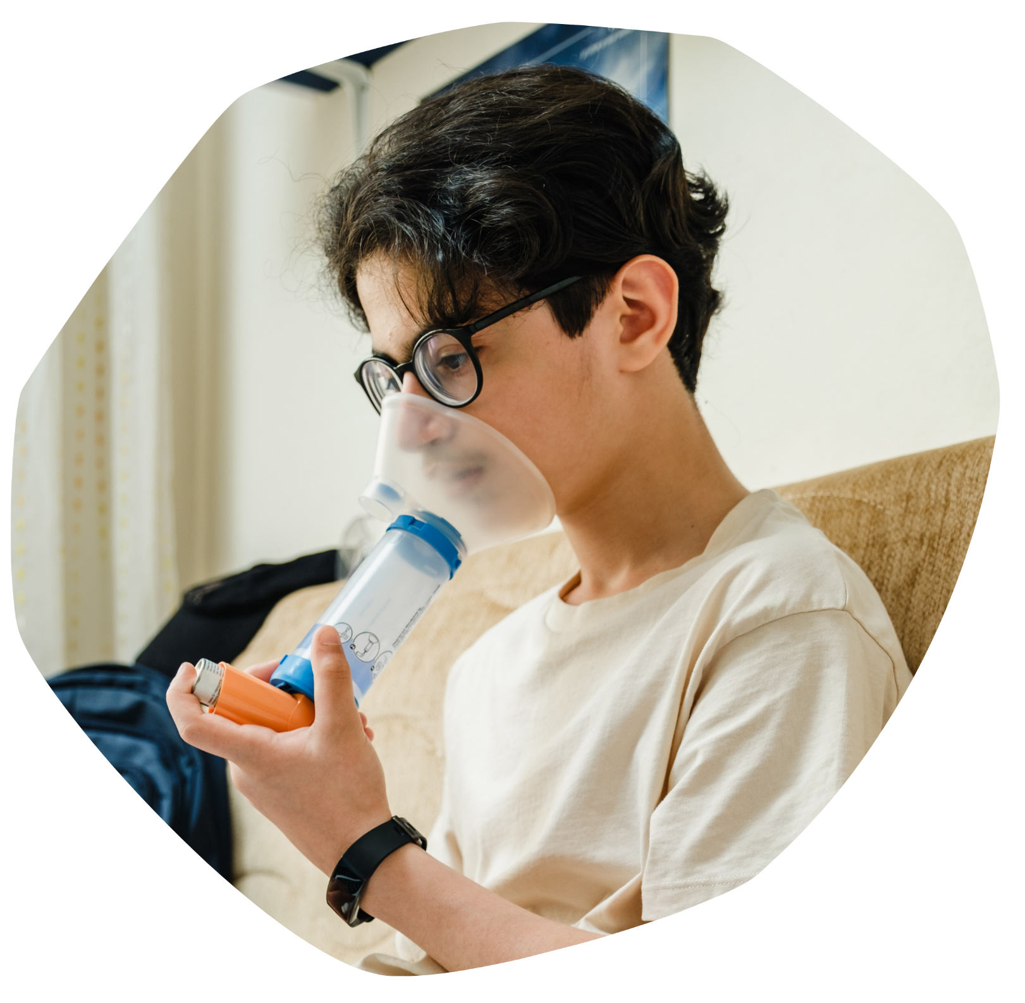
Knowing our bodies
Although the young person in the video was diagnosed with CF at the age of two, she said it wasn't really until much later that really affected her.
What happened and what was the impact on this young person?
The lungs of people with CF are more susceptible to infections and an infection will impact them more than it would most other people.

Slide 10
Treatments and medication
People with CF take various medications to manage their condition.
What sorts of treatments did we see in the video?
What do you think the average number of tablets a person with CF has to take each day?
10
20
40
60

Slide 11
Mental health and wellbeing
Do you think having a medical condition that affects you physically can also impact your mental health and wellbeing?
Let's find out about staying mentally well with CF.

Slide 12
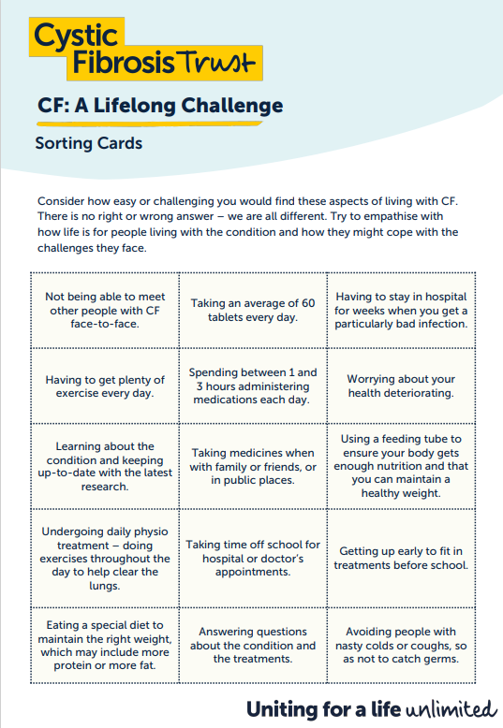
Mental challenges
People with CF often face mental challenges from the way the condition impacts their lives.
Look at your CF: A Lifelong Challenge Sorting Cards and put them in order of what you think you would find the most challenging to the easiest, if you had CF.

Slide 13
Mentally well
Looking after our mental health is important for everyone.
What strategies do you use to look after your mental health?
In the USA, in 2017, a study was carried out of 45 young people with cystic fibrosis. One of the areas they were asked about was their psychological wellbeing and coping strategies.
Let's find out more...

Slide 14
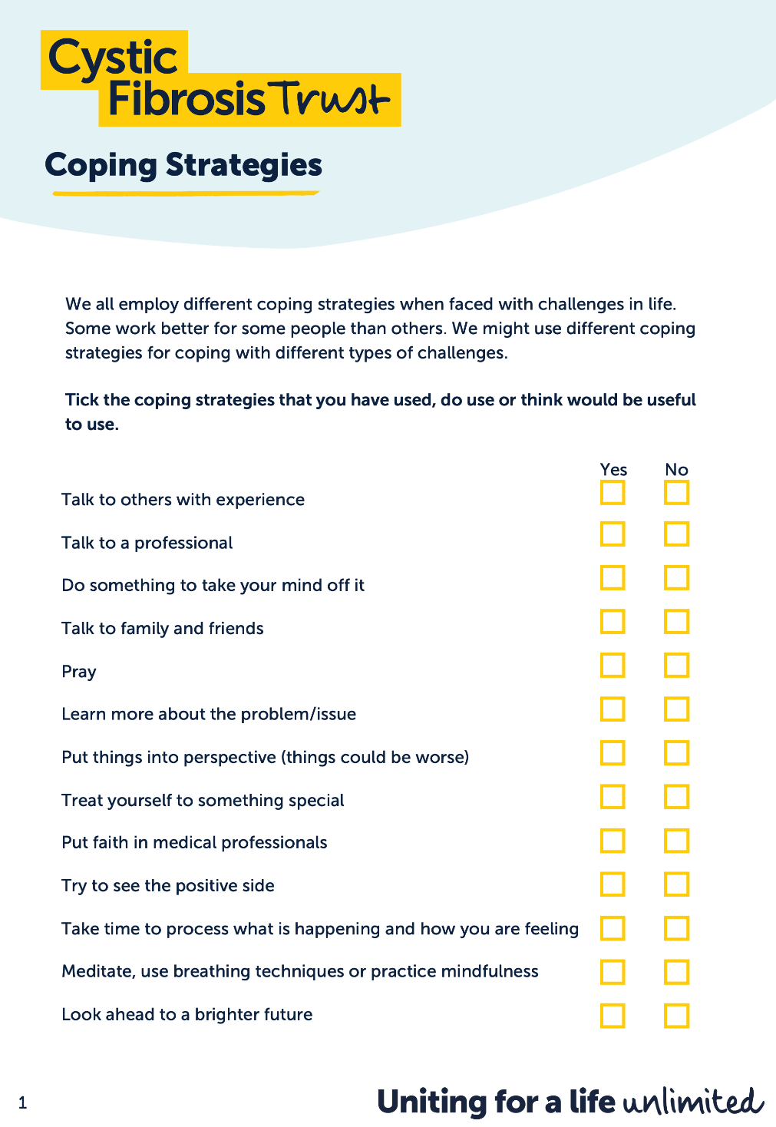
Coping strategies
A range of coping strategies were presented to the young people in the study, asking them which they used the most.
Many of the coping strategies are things anyone can try when they are facing challenges in life.
Take a look at your Coping Strategies list and tick those that you have successfully used or think might work well for you.

Slide 15
Information and support
For many people, coping with challenging circumstances – such as living with a health condition – involves getting support from reliable sources.
Health organisations, medical professionals and charities like Cystic Fibrosis Trust provide information, advice and support.
For example, Cystic Fibrosis Trust host a forum – an online space where people over the age of 18 can talk about anything related to CF.

Slide 16
The role of relationships
Connecting with others is an important element of looking after our mental health.
Just like anyone else, people with CF benefit from supportive family members and friends.
If you had a friend with CF – or another medical condition that impacted their life significantly – how might you be able to support them?

Slide 17
Let's recap...
We've learnt a lot about cystic fibrosis today and we've thought about how it impacts the lives of people with the condition.
Let's hear from some more young people about what it's like living with CF.

Slide 19
Cystic Fibrosis Trust is a UK charity who support people with CF and help fund research into treatments for the condition.
Think about everything we have learnt today about people who have CF. Why do you think Cystic Fibrosis Trust use the phrase 'Uniting for a life unlimited' in their campaign work?

