Slide 1





What is Cystic Fibrosis and How Does It Affect the Body?
Notes:
You will need to select the ‘enable content’ (top right) before starting the presentation to view the videos.

Slide 2




In this lesson, we’ll learn...
To define the terms non-communicable disease and inherited disorders.
To describe the main symptoms experienced by people with CF.
To explain how CF is inherited and how the main classes of CFTR mutation affect the body.

Slide 3
Starter activity
1. Try to match the condition on the left to the description on the right.
2. Can you identify something all these conditions have in common?
1. Sickle Cell Anaemia | A. This affects the movement of salt and water in and out of cells and leads to a build-up of sticky mucus in the lungs, digestive system and other organs.
2. Huntington’s Disease | B. This causes red blood cells to change from their usual doughnut shape to sickle shape which leads them to clump together and cause severe pain and organ damage.
3. Cystic Fibrosis | C. This causes nerve cells in the brain and central nervous system to degenerate in people when they reach their 30s or 40s.

Slide 4
The correct answers!
1. Sickle Cell Anaemia | B. This causes red blood cells to change from their usual doughnut shape to sickle shape which leads them to clump together and cause severe pain and organ damage.
2. Huntington’s Disease | C. This causes nerve cells in the brain and central nervous system to degenerate in people when they reach their 30s or 40s.
3. Cystic Fibrosis | B. This causes red blood cells to change from their usual doughnut shape to sickle shape which leads them to clump together and cause severe pain and organ damage.

Slide 5


What do these conditions all have in common?
They are all inherited.
Inherited diseases are caused by mutations or changes in chromosomes or genes that are passed down from parent to child.
They may be passed from one or both parents.
They cannot be ‘caught’ or spread through infection.
Write a definition of the terms:
Inherited disorders
Non-communicable disease

Slide 6
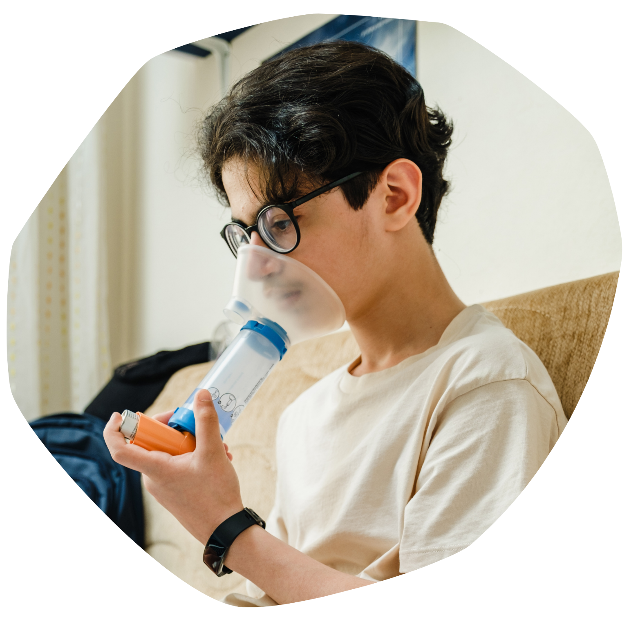
What is cystic fibrosis (CF)?
CF is an inherited and non-communicable condition that affects over 10,900 people in the UK.
We are going to watch a short video about CF. As you watch the video, write down:
1 thing you already knew about CF.
2 things that you learned about CF from this video.
1 thing that surprised you most about CF.

Slide 7
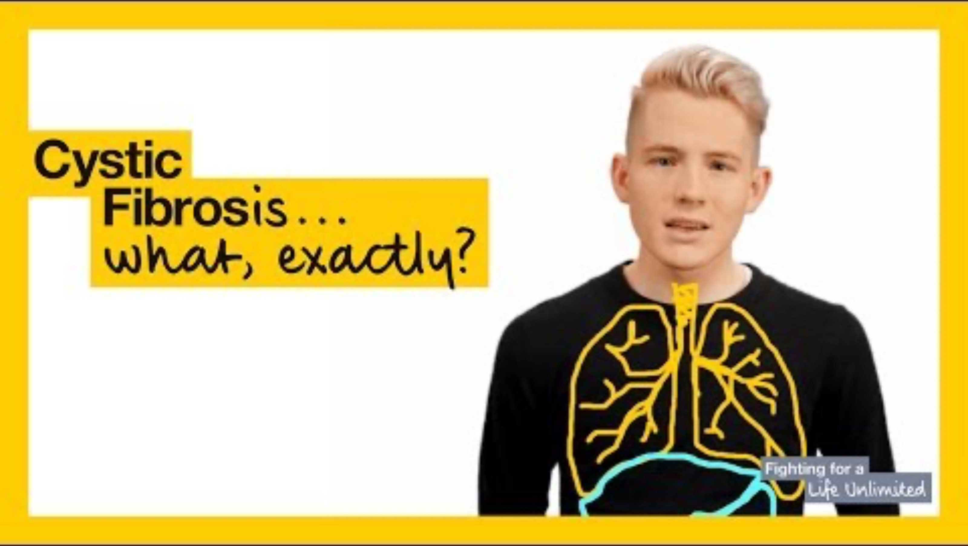

Slide 8

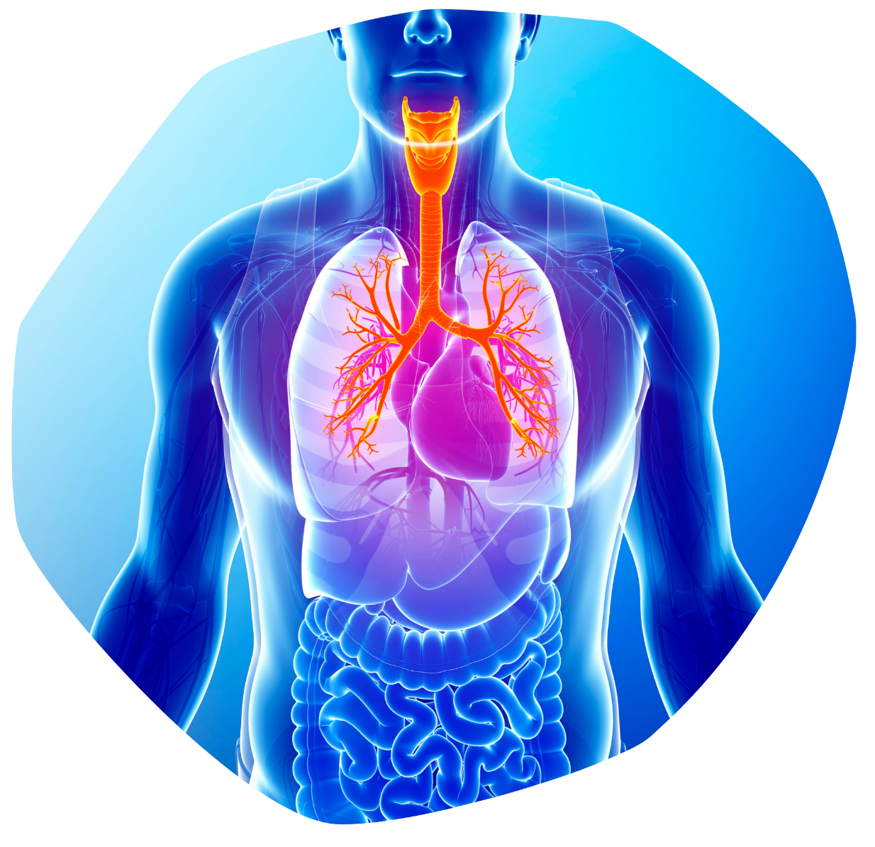

How CF affects the body
As we learnt from Charles in the video, CF can affect the body in various ways.
Look at your CF Information Sheet. Write down one sentence that explains how CF can affect:
The lungs
The liver
The pancreas
Fingers and toes
Mental health
Finally, describe any other impacts it can have

Slide 9

One in 25 of us carries the faulty gene that causes CF
So how is it passed on? And how does the gene variant lead to having CF?
Look at your CF Guided Reading Sheet.
First, closely read the text.
Then, for each paragraph, underline three keywords or terms. In the spaces underneath the paragraph, write a definition for each term.
Finally, come up with a title for each paragraph that neatly summarises its contents.

Slide 10




As we saw in Charles's video, there is no cure for CF.
However, due to various treatments and developments, people with CF can still lead rich and fulfilling lives.
One of the treatments has been the development of SMIs.
Let’s watch another video to learn more. As you watch the video, make a note of what SMI stands for and answer the following questions:
Which class of mutations are potentiator SMIs used to treat?
What is an example of an SMI used to treat Class II mutations?
SMIs are more commonly known as small molecule medicines. Modulator therapies are an example of these.

Slide 11


Slide 12

Can you…
Define the terms non-communicable disease and inherited disorders?
Describe the main symptoms experienced by people with CF?
Explain how CF is inherited and how the main classes of CFTR mutation affect the body?

Slide 13



Plenary
It’s time to pack away and show what you know by answering the True or False Quiz.
Remember to put your name on!

Slide 14

Cystic Fibrosis Trust is a UK charity who support people with CF and help fund research into treatments for the condition.
Think about everything we have learnt today about people who have CF. Why do you think Cystic Fibrosis Trust use the phrase 'Uniting for a life unlimited' in their campaign work?

Slide 15


