Slide 1

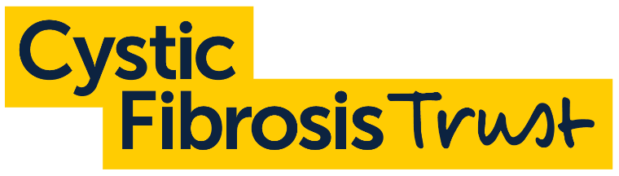



What is Cystic Fibrosis?
Notes:
You will need to select the ‘enable content’ (top right) before starting the presentation to view the videos

Slide 2




In this lesson, we’ll learn...
Why some people develop cystic fibrosis.
How cystic fibrosis can impact the lives of people who have it.
What some of the treatments available for cystic fibrosis are.

Slide 3


Starter activity
Match the term on the left to its definition on the right.
1) The passing on of genetic information and traits from parents to their offspring.
A) Contagious
2) The process of identifying a disease, illness or injury based on its symptoms.
B) Treatment
3) A disease or illness that spreads from one person or organism to another.
C) Diagnosis
4) Something designed to control a health problem, reduce its symptoms or clear it up.
D) Heredity

Slide 4
The correct answers!
How did you do?
3) A disease or illness that spreads from one person or organism to another.
4) Something designed to control a health problem, reduce its symptoms or clear it up.
A) Contagious
B) Treatment
2) The process of identifying a disease, illness or injury based on its symptoms.
1) The passing on of genetic information and traits from parents to their offspring.
C) Diagnosis
D) Heredity

Slide 5


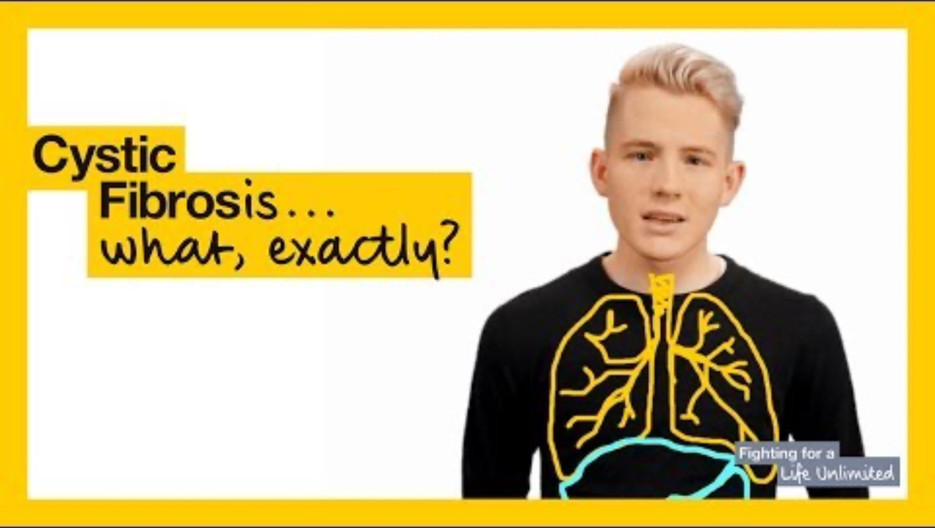
All about cystic fibrosis
Today, we are going to be learning about Cystic Fibrosis (CF).
This is a hereditary disease that affects around 11,000 people in the UK today.
But what is CF, exactly?
Let’s find out in this video. As we watch, you’ll complete your question sheets.
Read through the questions now to see what information you need to listen out for.

Slide 6
What is cystic fibrosis, exactly?
Answers from the video
5
1. How many babies are born with cystic fibrosis every week?
2. Cystic fibrosis affects the movement of what two things in the body?
Water and salt
3. What two parts of the body are mainly affected by cystic fibrosis?
The lungs and digestive system
4. List 3 typical symptoms someone with cystic fibrosis might experience.
Frequent chest infections,
severe coughs, wheezing or shortness of breath, abnormal bowel movements, difficulty gaining weight and, for most men, infertility
5. List 3 treatments that someone with cystic fibrosis might receive to help lessen their symptoms.
Antibiotics, physiotherapy, enzyme capsules, special high-fat diets, drugs that thin the mucus
6. How many tablets do some people with cystic fibrosis take in a day?
40

Slide 7

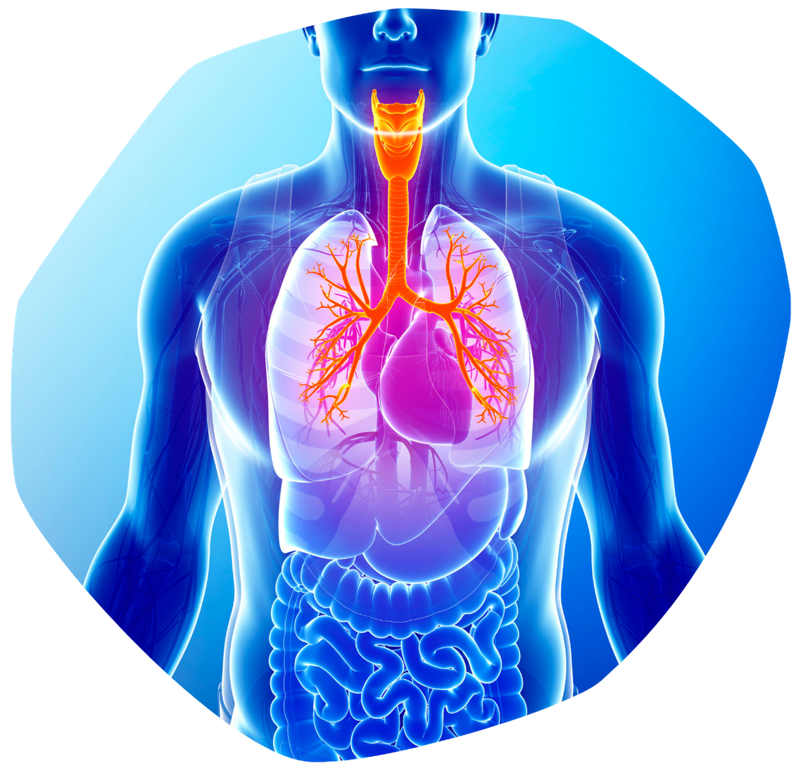
How CF affects the body?
As we just heard, the places most commonly affected by cystic fibrosis are the lungs and the digestive system.
However, there are over 1,400 possible mutations of the faulty gene that causes cystic fibrosis.
This means the way it affects people can vary from person to person.

Slide 8

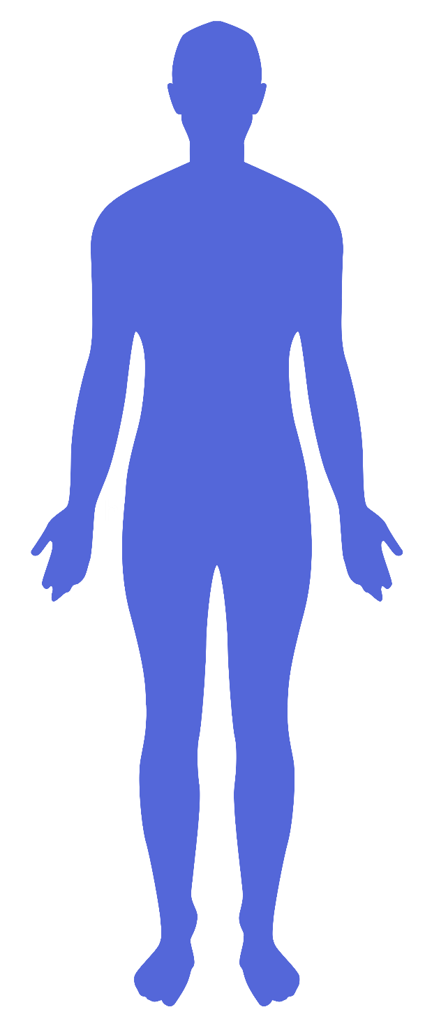


How does CF affect the body?
Read through the information sheet carefully
Label the various body parts that can be affected by cystic fibrosis and describe how that body part is impacted.
Try to keep your annotations to a single sentence.

Slide 9




Can you…
Explain why some people develop cystic fibrosis?
Describe how cystic fibrosis can impact the lives of people who have it?
Tell someone what some of the treatments available for cystic fibrosis are?

Slide 10



Treatments for cystic fibrosis
There are no treatments that will make cystic fibrosis go away. There are, however, a number of treatments that can greatly improve the quality of life of someone with cystic fibrosis.
Let’s learn more about these treatments.
As we go through the following slides, your task is to identify and record:
The name of the treatment
How it benefits the person with cystic fibrosis
Any possible negative aspects of the treatment

Slide 11



Treatment 1: Physiotherapy
Many different physiotherapy techniques can help people clear their airways of mucus.
These include breathing techniques, percussions or vibrations (clapping the chest rhythmically) and Positive Expiratory Pressure (breathing through a mask or mouthpiece to help build pressure behind mucus).
Physiotherapy is vitally important for all people with cystic fibrosis, including babies, and is adapted to suit their specific needs.

Slide 12


Treatment 2: CFTR modulators
These are a type of drugs that can lead to an increase in lung function for some people with cystic fibrosis.
They only help people with certain gene variants and some people will feel no benefits at all.
Some people experience side effects such as ‘brain fog’ or weight gain. This can cause stress and negatively impact people’s body image.
For people who find that CFTR modulators are not effective, the disappointment can be difficult to cope with.

Slide 13



Treatment 3: Antibiotics
Antibiotics are used to prevent, remove and control infections in the respiratory systems of people with cystic fibrosis.
The development of antibiotics in the second half of the 20th century is one of the major reasons for the increased life expectancy that has occurred in recent decades.
In recent years, infections that are resistant to antibiotics have become more common.
Fungal infections, which are also untreatable with antibiotics, are occurring more often too.

Slide 14

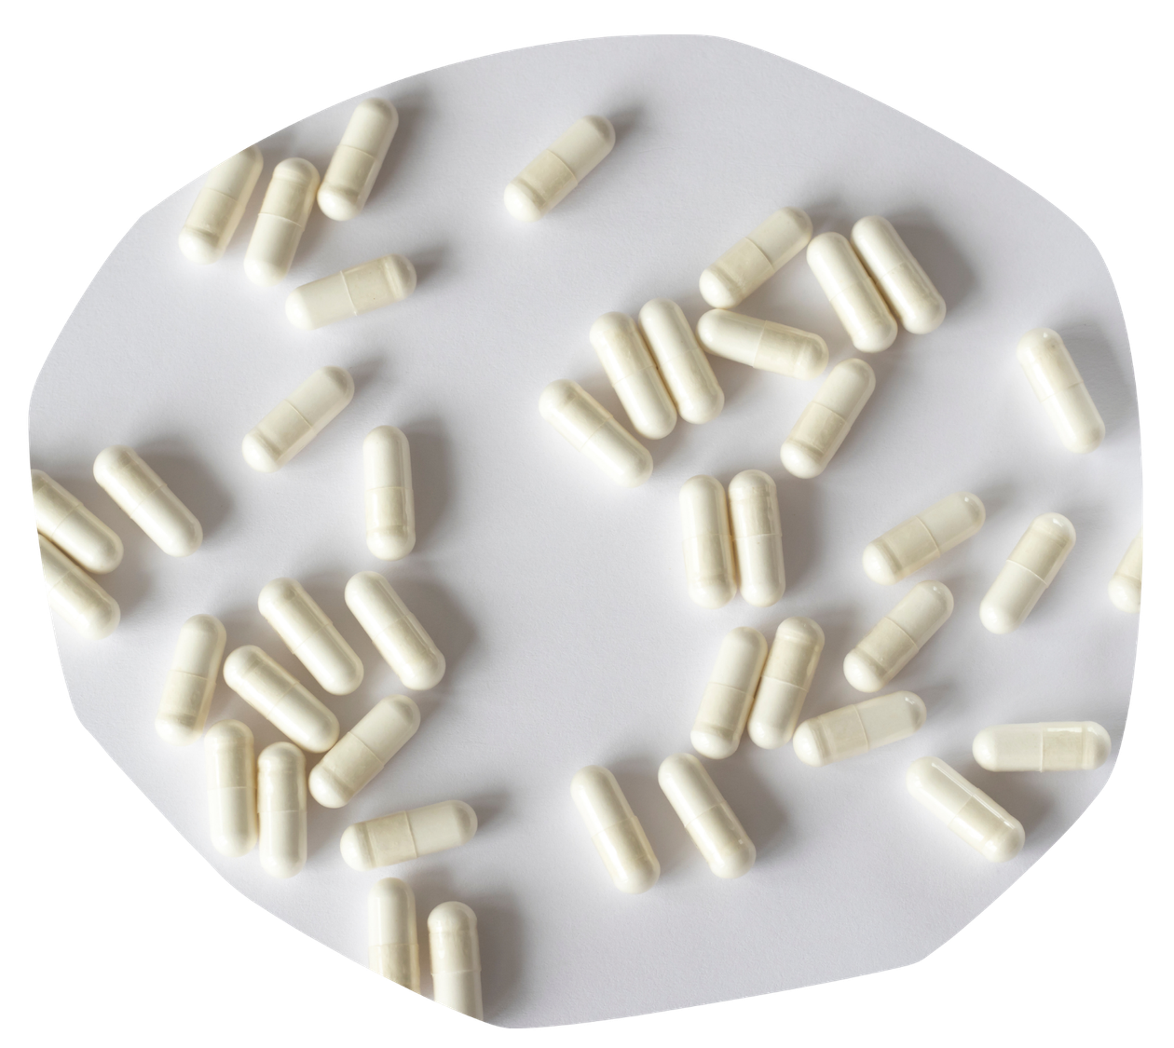
Treatment 4: Enzyme capsules
Enzyme capsules replace the enzymes that are normally released by the pancreas.
These help break down food more effectively and mean nutrients can be extracted from food.
Enzyme capsules need to be taken with every meal and the exact amount varies from person to person.
If a person with cystic fibrosis takes too few, they may not absorb the nutrients they need.
If they take too many, they could cause damage to their intestines.

Slide 15

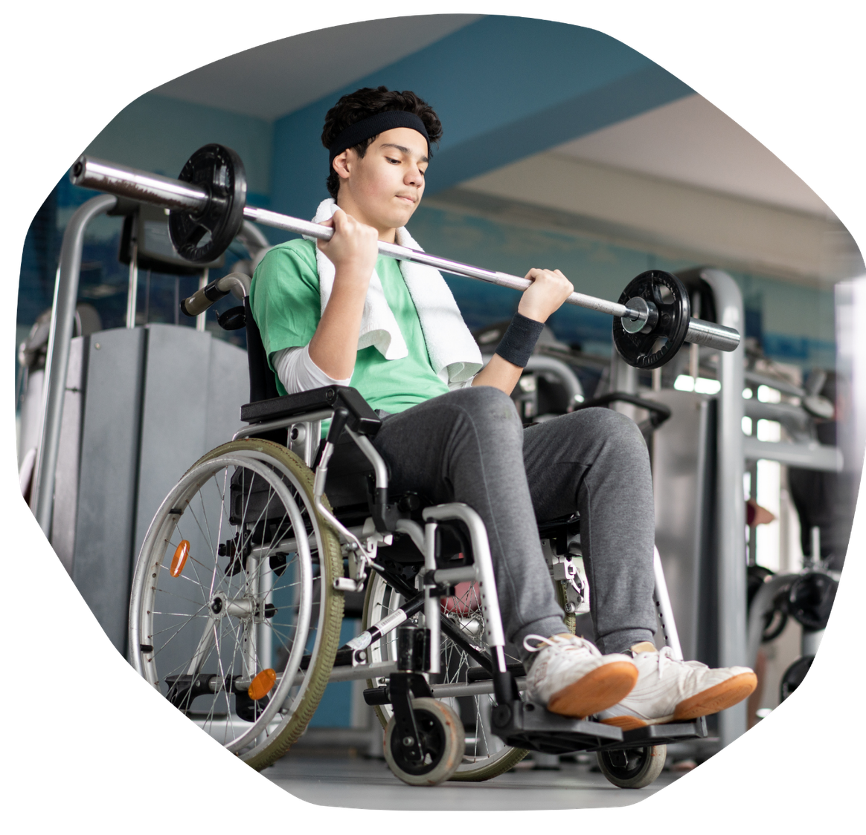

Treatment 5: Physical activity
Being physically active leads to a host of benefits for people with cystic fibrosis.
Amongst other things it:
improves lung function and clears mucus
improves bone density and makes them stronger
increases muscle strength and improves posture
aids digestion
is excellent for mental health

Slide 16


Treatment 6: Diet
The energy needs of people with cystic fibrosis are estimated to be around twice that of people without it.
Therefore, high-calorie, high-fat diets are recommended.
The ideal weight varies from person to person.
Eating enough calories to maintain a healthy weight can be a struggle for some people with CF as it is difficult to eat when feeling poorly.

Slide 17





Now, for all six treatments…
Create a simple image, icon, graphic or diagram that visually represents it.
What image would be a good representation of a high-fat diet, for example?

Slide 18


Can you…
Explain why some people develop cystic fibrosis?
Describe how cystic fibrosis can impact the lives of people who have it?
Tell someone what some of the treatments available for cystic fibrosis are?

Slide 19

Cystic Fibrosis Trust is a UK charity who support people with CF and help fund research into treatments for the condition.
Think about everything we have learnt today about people who have CF. Why do you think Cystic Fibrosis Trust use the phrase 'Uniting for a life unlimited' in their campaign work?

Slide 20
